Slide 1
COMP90024:Cloud & Cluster Computing
Group 51:
Boyang Yue 987093
Tong Niu 977082
Zihan Deng 983358
Ziyu Wang 962621
Zongru Li 947539

Slide 2
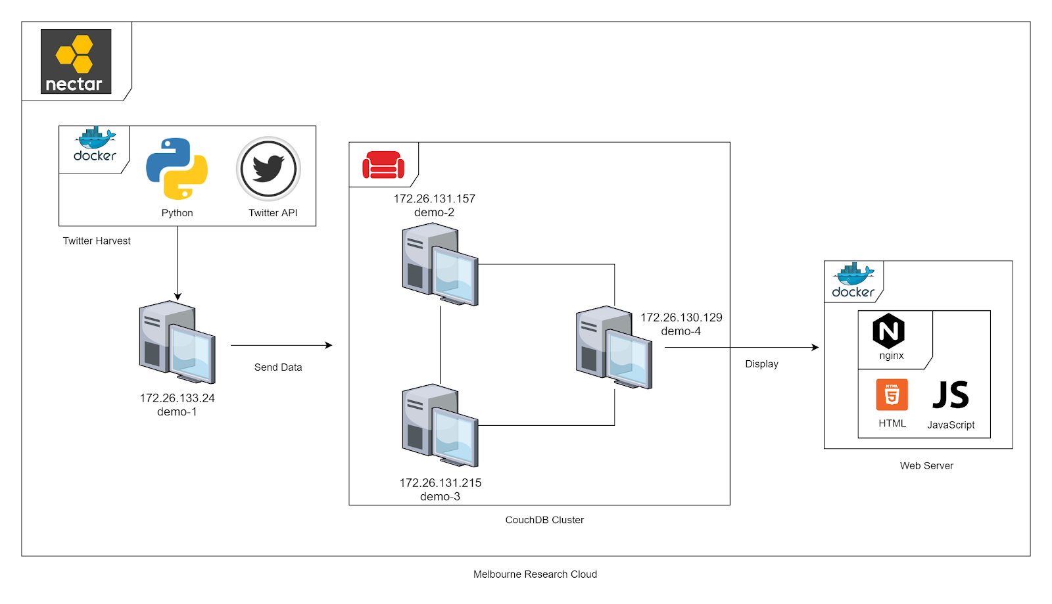
Architecture
Development of the system and why

Slide 3
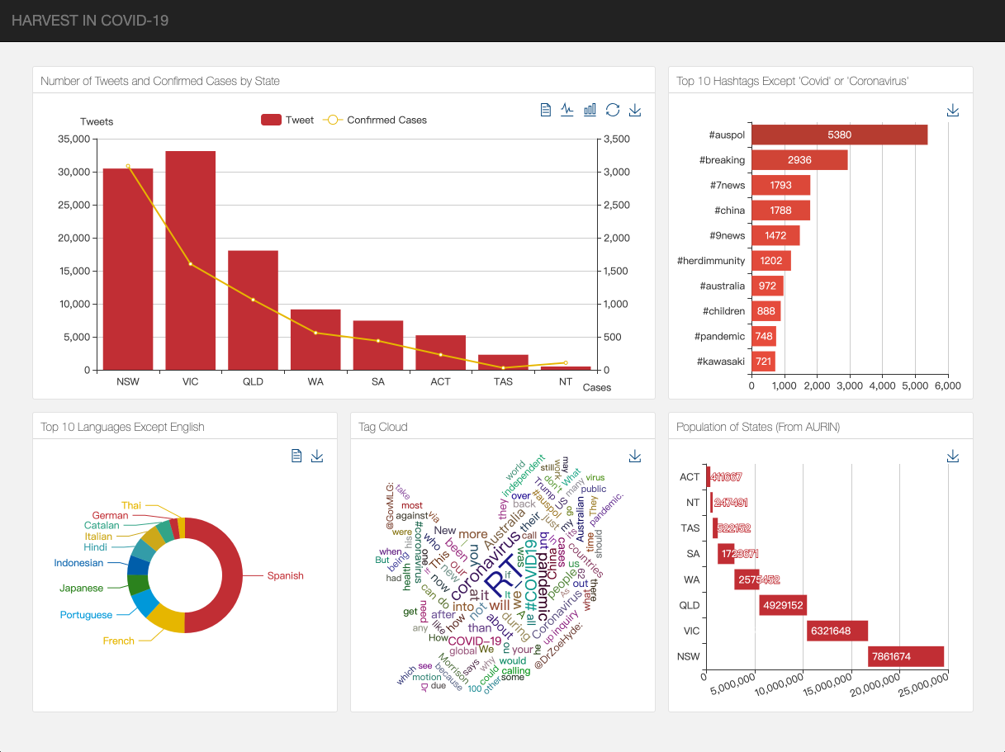
Data Analysis & Scenarios
How data is analyzed and scenarios are found

Slide 4
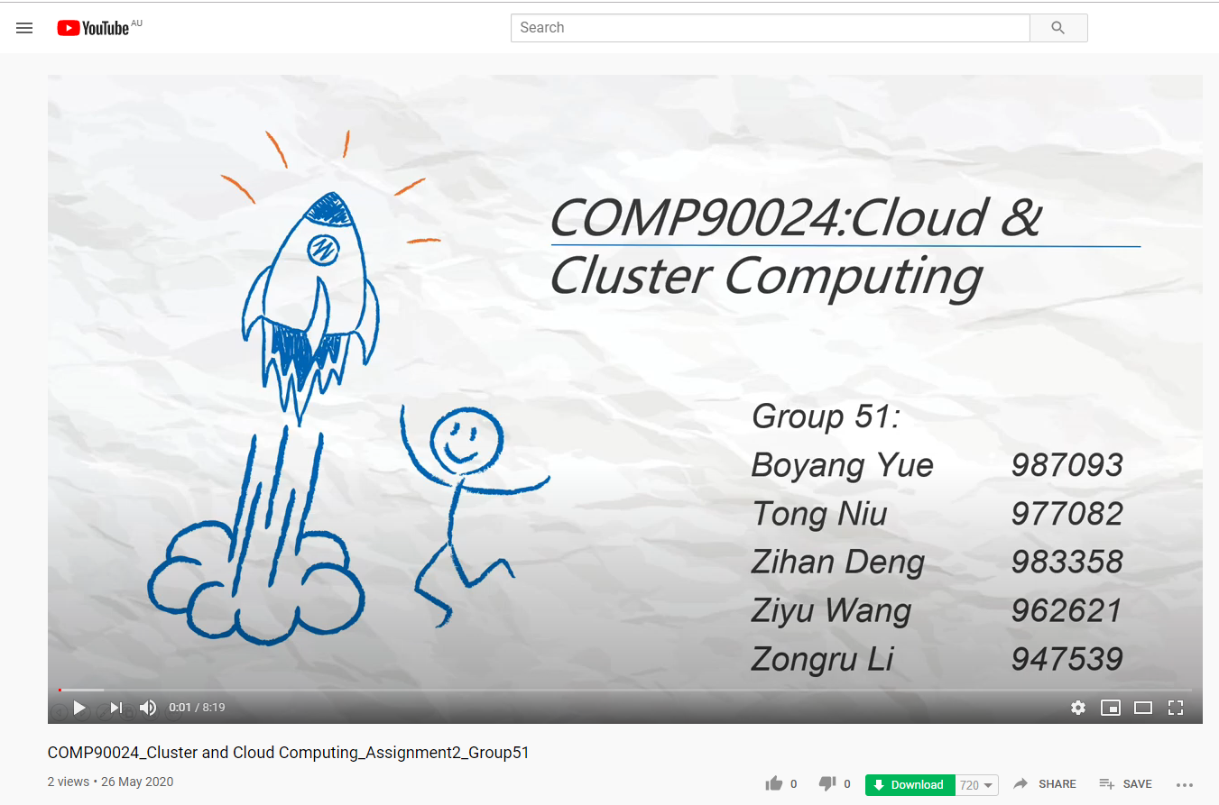
Video Demo
Click the link below to view the video:
https://youtu.be/3EfNvGMjbSo

